Slide 1
Multicurrency Reserving
24 September 2013

Slide 2
Lesson objectives
By the end of this lesson, you should be able to:
Describe what multicurrency reserving is and why carriers need it
Describe how ClaimCenter manages reserves that are in a currency other than the claim currency
Create a reserve in a currency other than the claim currency
Configure multicurrency features
This lesson uses the notes section for additional explanation and information. To view the notes in PowerPoint, choose View→Normal or View→Notes Page. If you choose to print the notes for the lesson, be sure to select “Print hidden slides.”

Slide 3
Lesson outline
Multicurrency mode (review)
Multicurrency reserving
Creating reserves in non-claim currency
Configuring multicurrency features

Slide 4
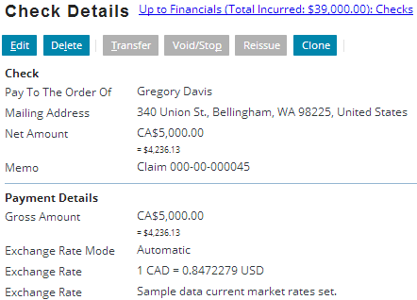
Multicurrency
Multicurrency mode provides the ability to display and process financial transactions in multiple currencies
Costs may need to be calculated in global currencies, depending on the loss location, residence, other factors
Payment for CA$5,000.00 Canadian dollar cost incurred; this is $4,236.13 US Dollars

Slide 5
Multicurrency in ClaimCenter 7
ClaimCenter 7 with multicurrency mode enabled offers several features, which meet the needs of many carriers
The default currency is the currency of record for the ClaimCenter implementation, set in the config.xml file
Set the DefaultApplicationCurrency parameter
Must match a currency specified in the Currency typelist
Individual policies can have a policy currency which may be different from the implementation's default currency
The claim currency derives from the policy currency
Individual transactions can have a transaction currency which may be different from both the policy and default currencies
Notes:
The claim currency is always the same as the policy currency.

Slide 6
Multicurrency in ClaimCenter 7 Continued
Individual reserves may be set in a different currency
Always tracked in the claim currency
Checks and payments may use any currency
The amount in the claim currency remains fixed
Reserves in the transaction currency may become inadequate if the claim currency becomes relatively stronger due to exchange rates changing in favor of the claim currency
June 24: € 1,00 = $US 1.25
Add reserve line of € 1600,00
Actual reserve is $US 2000.00
June 26: € 1,00 = $US 1.60
$US 2000.00 reserve is now equal to € 1250,00
Reserve may no longer be adequate

Slide 7
Lesson outline
Multicurrency mode (review)
Multicurrency reserving
Creating reserves in non-claim currency
Configuring multicurrency features

Slide 8

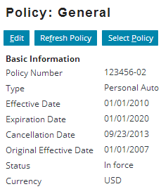

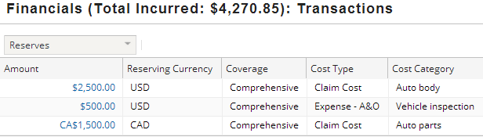
Multicurrency reserving
Multicurrency reserving is the ability to set reserves in multiple currencies on the claim
Payments erode reserve in the reserve currency
Each reserve line on a claim can have different currencies
Claim currency: USD
Reserving currency: CAD
Notes:
Any given reserve line has one and only one currency (the “Reserving Currency”).
Without multicurrency reserving:
Reserving done in currency other than claim currency is effectively converted to claim currency
Adjuster does not know exact amount of alternative currency as previously reserved
If claim currency weakens against alternative currency, reserve amount may no longer be adequate

Slide 9
Example: cross-border scenarios
In cross-border scenarios, carriers that issue policies in one currency need to process transactions in other currencies
Example: US resident drives into Canada, has an accident, and needs repairs paid in Canadian dollars
Typically does not require multicurrency reserving
reserve transaction
+$2000 USD
-CA$1850 CAD
payment transaction
Notes:
US Dollars are indicated with the simple dollar symbol ($) in the application.
Canadian Dollars are indicated with a prefix of CA (CA$) in the application.
Australian Dollars are indicated with a prefix of AUS (AU$) in the application.
Russian Federation Rubles are indicated with a prefix of RUB (RUB) in the application.
All other base application currencies provided use the appropriate symbol (Euros, Pounds, Yen, etc.)

Slide 10
Who needs multicurrency reserving?
Carriers that need to track reserves in currencies other than the policy currency
Carriers that only track reserves in the claim currency do not need multicurrency reserving
$
€
£

Slide 11
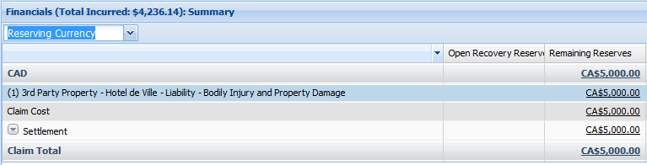
Tracking reserves
When multicurrency reserving is enabled, reserves are tracked and eroded in currency in which they were created
Exchange rate fluctuations do not affect the reserve amount remaining on a reserve line
Financials Summary screen can be sorted by currency
Fixed in face of exchange rate fluctuations

Slide 12
Currency Reserve Lines Available
In the base application, the following currencies are enabled and supported for multicurrency reserving:
AUD – Australian dollar
CAD – Canadian dollar
EUR – European Union euro
GBP – British pound
JPY – Japanese yen
RUB – Russian ruble
USD – U.S. dollar
You may alter the currencies listed above, as well as add/remove additional currencies using configuration tasks.

Slide 13
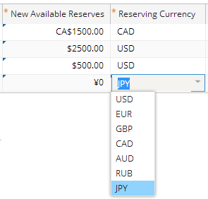
Reserving currency
Reserving currency is the currency in which amounts associated with a given reserve line are tracked
Each reserve line has designated reserving currency (default is the claim currency)
User may select a reserving currency for each reserve line

Slide 14
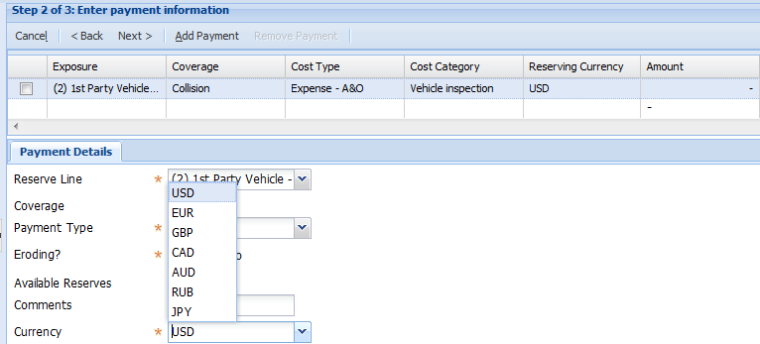
Payments
Payments erode reserves in the Reserve Line currency, based on the foreign exchange rate on the day they are submitted
Payments can be made in any currency, but all payments on a single checkset must be from the currency of the reserve line
You can create checks in any currency

Slide 15
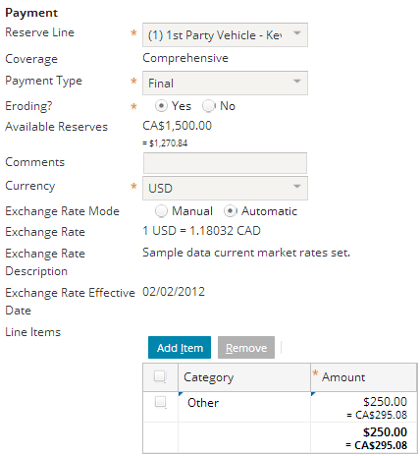
Payments Continued
When you set the payment currency to be different from the reserving currency, the exchange rate appears on the screen
The conversion rate from the payment currency to the reserving currency is displayed

Slide 16
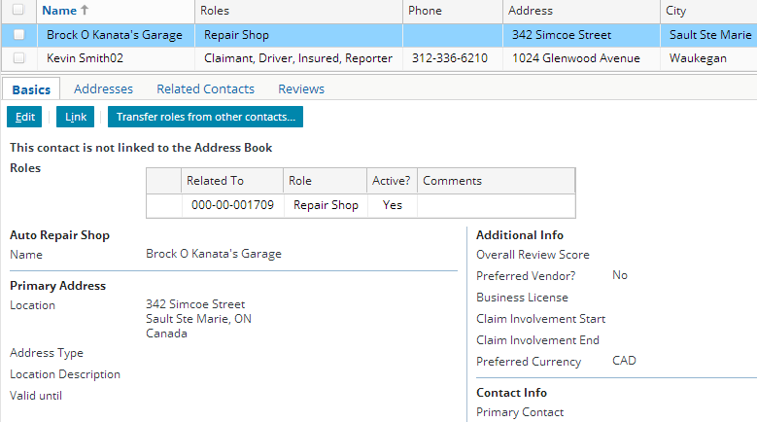
Preferred currency
Can specify Preferred Currency for vendors and other potential payees
If vendor is selected as payee, the reserve defaults to their Preferred Currency

Slide 17
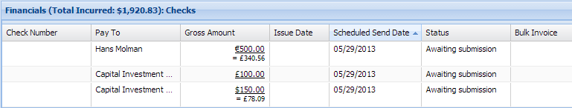
Transaction display
Transactions in non-reserve currency are displayed in transaction currency along with equivalent in reserve currency
£
€
£
£
£
$
Notes:
UK Pounds is the claim currency in the example shown. In the first line, Euros are the transaction (check) currency on a GBP reserve line.
In the second line, GBP (Pounds) are the transaction and reserve currency, so no currency changes were made during transaction processing.
In the third line, US Dollars are the transaction (check) currency on a GBP reserve line.

Slide 18
Lesson outline
Multicurrency mode (review)
Multicurrency reserving
Creating reserves in non-claim currency
Configuring multicurrency features

Slide 19
Creating reserve in non-claim currency
Scenario:
Claim currency is in dollars
Liability for lost wages reserving currency is in euros
Select Actions > Reserve
Establish reserving currency (default is claim currency)
Set New Available Reserves in reserve currency

Slide 20
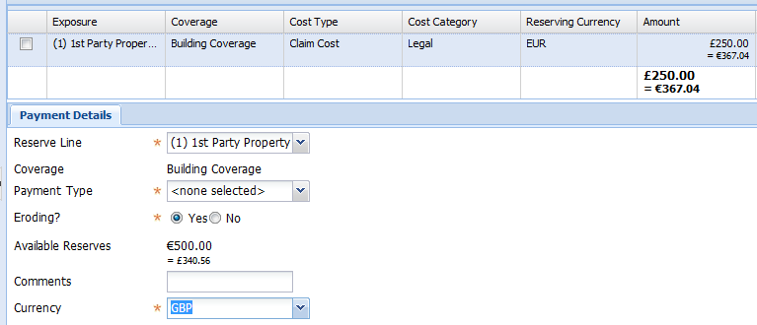
Making payments
Create check in ordinary manner
If currency overridden, Payment amount is displayed in Transaction currency and converted to Reserving currency
Available reserves tracked and displayed in reserving currency
If currency overridden, Available reserves tracked in Reserving currency and converted to Transaction currency
GBP is selected as check currency, overrides reserving currency
Select reserve line
Notes:
Default currency for a payment is the reserving currency.

Slide 21
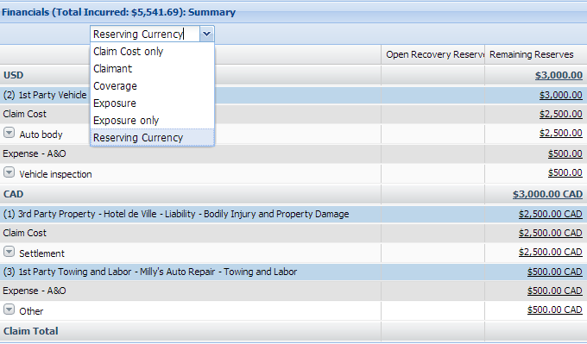
Viewing financial summary
Can view in reserving currency
Total incurred tracked in claim currency
Unless overridden payment is in reserving currency

Slide 22
Lesson outline
Multicurrency mode (review)
Multicurrency reserving
Creating reserves in non-claim currency
Configuring multicurrency features

Slide 23

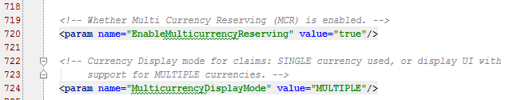

Enabling multicurrency
Multicurrency mode must be enabled in the base application
Multicurrency mode is enabled using config.xml parameters: EnableMulticurrencyReserving & MulticurrencyDisplayMode When set to MULTIPLE, multicurrency mode is enabled:
Ensure the Currency typelist is also configured to support single/multi-currency and/or upgrades:
Single Currency: Remove all currency typecodes except for the default application currency typecode.
Multiple Currency: Add or delete currency typecodes as necessary for your installation.
Upgrading Multicurrency: Retire all currency typecodes that you do not intend to use in the upgraded installation.
Notes:
Multicurrency mode is supported from ClaimCenter 7 onward; however, the multicurrency features described in this lesson are supported only with the release of ClaimCenter 8. If you do not enable multicurrency reserving, then you will see no difference from ClaimCenter 7 multicurrency functionality.
The lines below the two parameters in config.xml determine the default currency for ClaimCenter (system-wide). In the base application, the default currency is United States Dollars (USD) (Visible if you choose View > Notes Page):
For more information, consult the “Configuring Currencies” chapter of the ClaimCenter 8.0.0 Globalization Guide.

Slide 24
Enabling multicurrency Continued
Multicurrency Reserving is enabled using the parameter EnableMulticurrencyReserving in config.xml
When false, reserves are tracked/eroded in claim currency
Exchange rate fluctuations affect the reserve amount remaining on a reserve line
When set to true, reserves are tracked/eroded in currency in which they were created
Exchange rate fluctuations do not affect the reserve amount remaining on a reserve line
This parameter is true in the base application (8.x)
WARNING: Once the application server has been started once, you cannot change from MULTIPLE to SINGLE unless you drop the database completely. The server will not start if this change has been made.
Notes:
The functionality described in this lesson assumes multicurrency and multicurrency reserving is enabled.

Slide 25
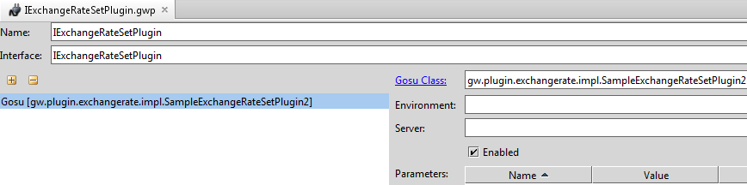
Enabling exchange rate updates
In order to use multicurrency, you must implement the IExchangeRateSet plugin
Guidewire provides two sample implementations in gw.plugin.exchangerate.impl
This plugin obtains current exchange rates from your chosen foreign exchange service and uses them to create exchange rate sets
Notes:
Implementing plugins is beyond the scope of this course. For further information, take the ClaimCenter 8 Integration course.
The base application contains a stub implementation that obtains exchange rates from the sample data. (This is one of the two sample implementations provided. The other is an implementation to get exchange rate updates from the New York Federal Reserve.)

Slide 26
New financial calculations API
Get consolidated totals for a claim in the claim currency
See incurred for the claim in a single currency
Verify limits on the policy are not exceeded
Get financial totals in claim currency with
Reserves and Recovery Reserves valued at the market exchange rate (floating)
Payments and Recoveries valued at the exchange rate when they were created (fixed)

Slide 27
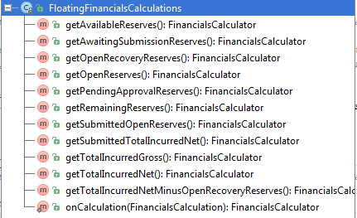
New financial calculations API (Continued)
The FinancialsCalculations API is available on gw.api.util.FinancialsCalculations.FloatingFinancials
In Gosu these get methods are exposed as properties
For example, FinancialsCalculations.FloatingFinancials.getOpenReserves()
Notes:
The totals for normal Financials Calculations in the claim currency are the totals of the ClaimAmounts on each transaction. These are set when the transaction is created, and generally not updated afterwards.
The FloatingFinancials API, when getting the "Amount" or "ClaimAmount" of the calculation, adds up the totals in each applicable Reserving Currency, and then converts that to claim currency using the current exchange rate.
For example, suppose you have un-eroded OpenReserves in EUR, that are not in claim currency, say USD.
The FloatingFinancials API gets the total OpenReserves in EUR by subtracting EUR payments from EUR reserves.
Then it converts the EUR OpenReserves to USD, to get a more realistic value for how much your Open Reserves in EUR are worth in USD right now.

Slide 28
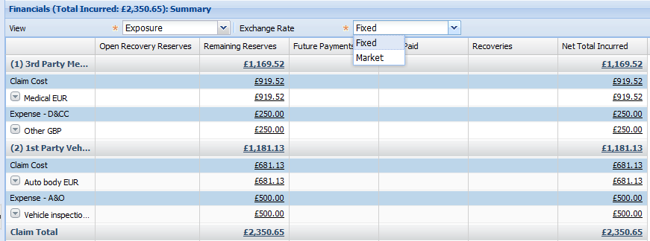
Market rate on financials summary
Changing the exchange rate dropdown to Market updates the financial summary to show amounts calculated by the floating financials API
Reserves valued at the current market rate
Notes:
In the example shown, the claim currency is GBP but several reserve lines are in EUR.
The FloatingFinancialsCalculations API provides functionality for calculating reserve/payment values from current market rates.

Slide 29
Financial calculations
Net Incurred calculation for a claim has a floating and a fixed part for MCR (multicurrency reserving) customers
Reserves must be calculated at the spot exchange rate and payments are valued with the exchange rate when they occur
Net Total Incurred = Available Reserves in reserve currency * Exchange rate [FLOATING] + Total payments in claim currency [FIXED]
Floating rate on day of display = 1.8
Net total incurred = £1000 * 1.8 + (750+600) = €3150
Total payments = €1350
Transaction | Reserve Amount | Claim Amount | Exchange Rate
Reserve | £2000 | €4000 | 2.0
Check | £500 | €750 | 1.5
Check | £500 | €600 | 1.2
Available Reserves | £1000

Slide 30
Lesson objectives review
You should now be able to:
Describe what multicurrency reserving is and why carriers need it
Describe how ClaimCenter manages reserves that are in a currency other than the claim currency
Create a reserve in a currency other than the claim currency
Configure multicurrency features

Slide 31
Review questions
What three things must you do to enable multicurrency reserving?
What kind of carriers need multicurrency reserving?
Suppose you have a claim where the policy currency is Euros and the reserving currency is UK Pounds. You create a reserve, and the value of the Pound against the Euro changes. What changes in ClaimCenter?
Notes:
Answers
Implement the IExchangeRate plugin; set MultiCurrencyDisplayMode to MULTIPLE in config.xml; and set EnableMulticurrencyReserving to true in config.xml (Assuming you are using two or more currencies provided by the base application). For example, if you wish to use Mexican Pesos as a reserving currency, you would have to also add the Peso (MEX) to the Currency typelist.
Carriers that need to track reserves in currency other than the policy currency.
The total amount of the claim reserves in the claim currency changes to accommodate the change in exchange rates.

Slide 32
Notices
Copyright © 2001-2014 Guidewire Software, Inc. All rights reserved.
Guidewire, Guidewire Software, Guidewire ClaimCenter, Guidewire PolicyCenter, Guidewire BillingCenter, Guidewire Reinsurance Management, Guidewire ContactManager, Guidewire Vendor Data Management, Guidewire Client Data Management, Guidewire Rating Management, Guidewire InsuranceSuite, Guidewire ContactCenter, Guidewire Studio, Guidewire Product Designer, Guidewire Live, Guidewire DataHub, Guidewire InfoCenter, Guidewire Standard Reporting, Guidewire ExampleCenter, Guidewire Account Manager Portal, Guidewire Claim Portal, Guidewire Policyholder Portal, ClaimCenter, BillingCenter, PolicyCenter, InsuranceSuite, Gosu, Deliver Insurance Your Way, and the Guidewire logo are trademarks, service marks, or registered trademarks of Guidewire Software, Inc. in the United States and/or other countries.
All other trademarks are the property of their respective owners.
This material is confidential and proprietary to Guidewire and subject to the confidentiality terms in the applicable license agreement and/or separate nondisclosure agreement.
This file and the contents herein are the property of Guidewire Software, Inc. Use of this course material is restricted to students officially registered in this specific Guidewire-instructed course, or for other use expressly authorized by Guidewire. Replication or distribution of this course material in electronic, paper, or other format is prohibited without express permission from Guidewire.
Guidewire products are protected by one or more United States patents.

